Slide 1
Collections

Slide 2

Collections Framework
A collection is a container object that represents a group of objects, often referred to as elements.
A collection allows a group of objects to be treated as a single unit

Slide 3
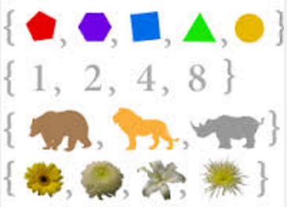

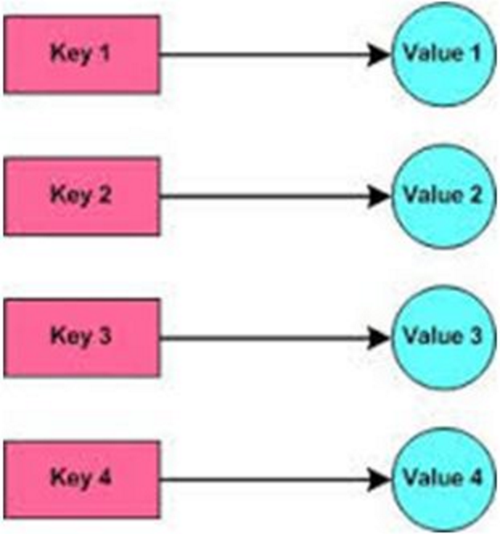
Collections Framework
The Java Collections Framework supports three types of collections
sets
lists
maps

Slide 4
Collections Framework
The collections framework is provided in java.util package and has three main elements
core interfaces, which allow collections to be manipulated independent of their implementation
small set of implementation classes, providing data structures for you to use
an assortment of algorithms, which can be used to perform various operations on collections, such as sorting and searching

Slide 5
Core Interfaces
Collection
basic interface that defines all collection operations
Set
extends the Collection interface for sets that maintain unique elements
List
extends the Collection interface for group of elements in a sequential order
Map
basic interface for a group of key to value mappings
Additional Interfaces
SortedSet
for sets with elements in sorted order
SortedMap
for maps with keys in sorted order

Slide 6
Basic Collection Methods
add(Object o), addAll(Collection c)
ensures that this collection contains the specified element
remove(Object o), removeAll(Collection c)
removes a single instance of the specified element from this collection, or all the elements
size()
returns the number of elements in this collection
clear()
removes all of the elements from this collection
toArray()
returns an array containing all of the elements in this collection
iterator()
returns an iterator over the elements in this collection

Slide 7
Iterator Pattern
The iterator pattern is a design pattern in which an iterator is used to traverse a container and access the container's elements
The iterator pattern decouples algorithms from containers

Slide 8
java.util.Iterator
Iterator provides a way to access the elements of the collection sequentially without exposing its underlying representation
boolean hasNext()
returns true if the iteration has more elements
Object next()
returns the next element in the interation
void remove()
removes from the underlying collection the last element returned by the iterator (optional operation)

Slide 9
Generic Iterators
To iterate over generic collections, you can use a generic iterator
List<String> listOfStrings = new LinkedList<String>(); ... for (Iterator<String> i = listOfStrings.iterator(); i.hasNext(); ) { String s = i.next(); System.out.println(s); }

Slide 10
Better Iterator
private void printListOfStrings(List<String> list) { for (String s : list ) { System.out.println(s); } }

Slide 11
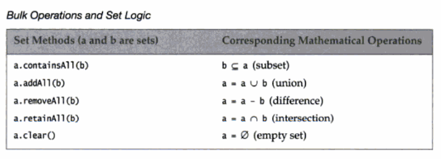
java.util.Set
implementations of Set will not allow duplicate elements
it does not add any new methods to Collection interface,
but adds the restriction that duplicates are not allowed
a Set models a mathematical set

Slide 12
java.util.HashSet
The HashSet class is a concrete class that implements the Set interface
It can be used to store duplicate-free elements
uses hashcode() to determine if an object has been added to the set
Results:
The size is: 4
a
is
This
test
HashSetExample

Slide 13
java.util.List
implementations will maintain their elements in sequential order or sequence
can contain duplicates
List interface adds list specific operations
access by numerical position
search in list
operations on parts of a list (called open range-view operations)
customized iterators

Slide 14
java.util.ArrayList
resizable-array implementation of the List interface
implements all optional list operations, and permits all elements, including null
in addition to implementing the List interface, this class provides methods to manipulate the size of the array that is used internally to store the list
capacity is the size of the array used to store the elements in the list
as elements are added to ArrayList, its capacity grows automatically
ensureCapacity() increases the capacity of an ArrayList instance before adding a large number of elements
reduces the amount of incremental reallocation

Slide 15
toArray
ArrayList<String> items = new ArrayList<String>(); items.add("Orange"); items.add("Green"); items.add("White");
String[] colours = items.toArray(new String[0]); CollectionUtil.display(colours);

Slide 16
ArrayList Example 1
see ArrayListExample1.java
The size is: 6
This
is
is
a
a
test

Slide 17
ArrayList Example 2
see ArrayListExample2.java
The size is: 6
This
is
is
a
a
test

Slide 18
java.util.LinkedList
can add elements at end and beginning to a LinkedList
The Example...
List where each element references previous and next element in the list

Slide 19
LinkedList Example
see ListExample.java
list where each element references previous and next element in the list
Results:
The size is: 6
This
is
is
a
a
test

Slide 20
ArrayList or LinkedList or Array?
If you need to support random access through an index without inserting or removing elements from any place other than the end, ArrayList offers the most efficient collection.
If, however, your application requires the insertion or deletion of elements from any place in the list, you should choose LinkedList.
A list can grow or shrink dynamically. An array is fixed once it is created. If your application does not require insertion or deletion of elements, the most efficient data structure is the array.

Slide 21

The Stack Class
The Stack class represents a last-in first-out stack of objects
The elements are accessed only from the top of the stack
You can retrieve, insert, or remove an element from the top of the stack
boolean empty() Tests if this stack is empty.
Object peek() Looks at the object at the top of this stack without removing it from the stack.
Object pop() Removes the object at the top of this stack and returns that object as the value of this function.
Object push(Object item) Pushes an item onto the top of this stack.
int search(Object o) Returns the 1-based position where an object is on this stack.

Slide 22
java.util.Map
interface Map maps keys to values
no duplicate keys
each key maps to only one value
value is retrieved based on a key
the keys order can be sorted (TreeMap), or not
methods:
put(Object key, Object value)
get(Object key)
remove(Object key)
containsKey(Object key)
containsValue(Object value) caution - could be expensive!

Slide 23
HashMap Example
see HashMapExample.java
Results:
The size is: 6
five=cinco
six=seis
two=dos
one=uno
three=tres
four=cuatro

Slide 24

More Inner Classes
Recall that inner classes are just classes declared within a class to serve to encapsulate a particular behaviour to be used by the outer class
Anonymous Inner Classes
If the inner class is used one (like we do for new Lab1().run()), then we can skip the separate class declaration and simply declare and use it "in place"
Static Inner Classes
Sometimes it's convenient to group a number of simple, related inner classes in an outer class
The outer class simply serves as a container
CompareSortExample

Slide 25
Using Comparator with Collections
Comparators can be used to control the order of certain data structures
Leopard
Deer
Cow
Cat
Cougar
Lion
Dog
--------------------------
Cow
Cat
Dog
Deer
Lion
Cougar
Leopard
Notice that sorting is based on word length;
not alphabetic order
CompareSortExample

Slide 26
The Collections Class
The Collections class contains various static methods for operating on collections and maps, for creating synchronized collection classes, and for creating read-only collection classes
TestCollections

Slide 27
The Arrays Class
The Arrays class contains various static methods for sorting and searching arrays, for comparing arrays, and for filling array elements
It also contains a method for converting an array to a list
Arrays
TestArrays

